Slide 1
The Transport Layer
The Transport Service &
Elements of Transport Protocols
Chapter 6

Slide 2
Transport Service
Services provided to the Upper Layers
Transport Service Primitives
Berkeley Sockets
Example of Socket Programming:
Internet File Server

Slide 3
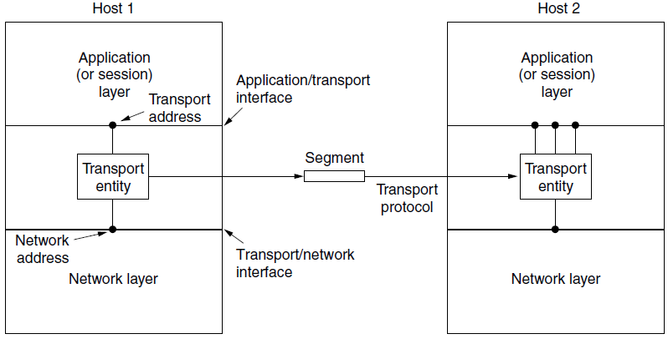
Services Provided to the Upper Layers
Fig.: The network, transport, and application layers
  Transport layer responsibilities:
  Establishment, data transfer and release
  Make it more reliable than the underlying layer

Slide 4
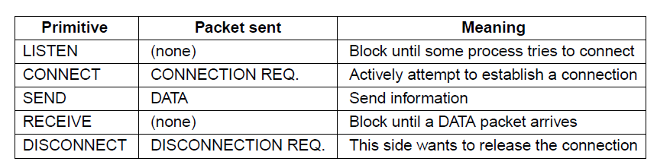
Transport Service Primitives (1)
The primitives for a simple transport service

Slide 5
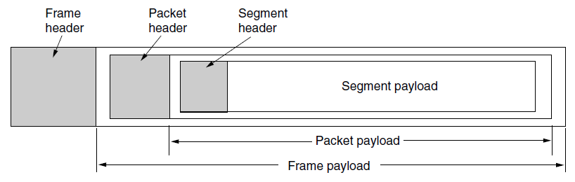
Transport Service Primitives (2)
Nesting of segments, packets, and frames.

Slide 6
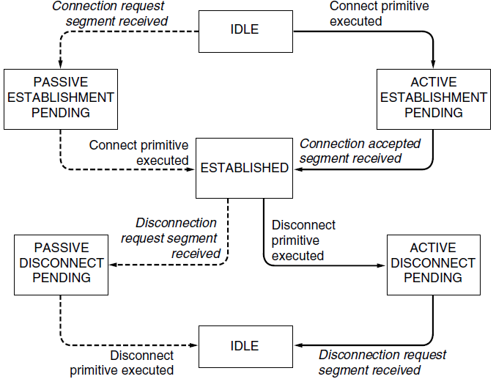
Berkeley Sockets (1)
A state diagram for a simple connection management scheme. Transitions labeled in italics are caused by packet arrivals. The solid lines show the client’s state sequence. The dashed lines show the server’s state sequence.

Slide 7
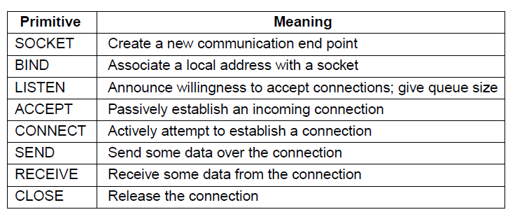
Berkeley Sockets (2)
The socket primitives for TCP

Slide 8
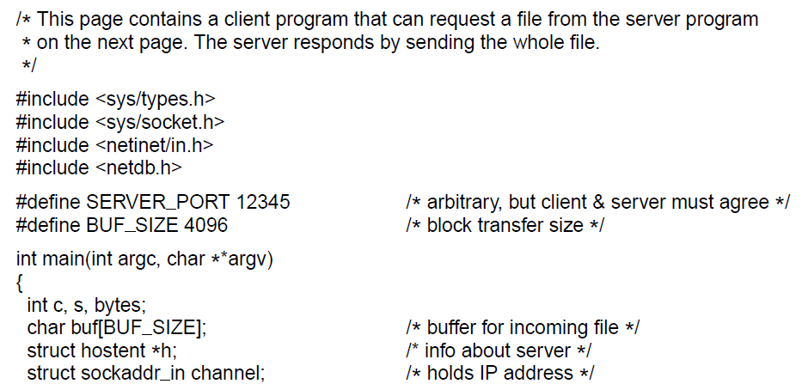
Example of Socket Programming:
An Internet File Server (1)
. . .
Client code using sockets

Slide 9
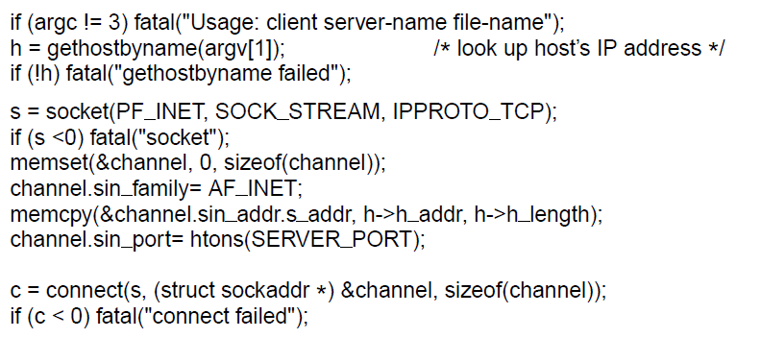
Example of Socket Programming:
An Internet File Server (2)
. . .
. . .
Client code using sockets

Slide 10
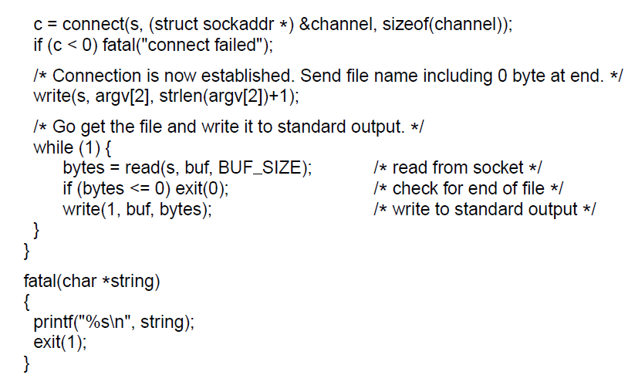
Example of Socket Programming:
An Internet File Server (3)
. . .
Client code using sockets

Slide 11
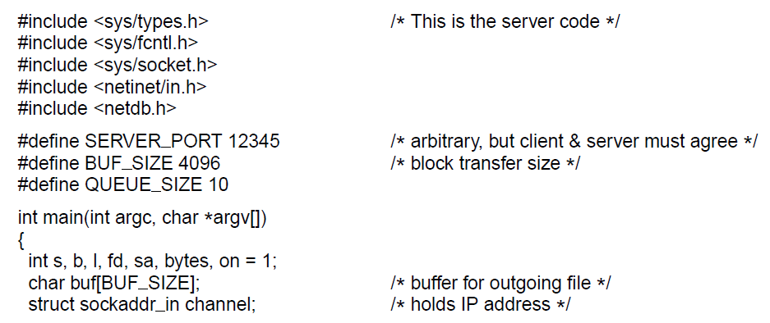
Example of Socket Programming:
An Internet File Server (4)
. . .
Server code

Slide 12
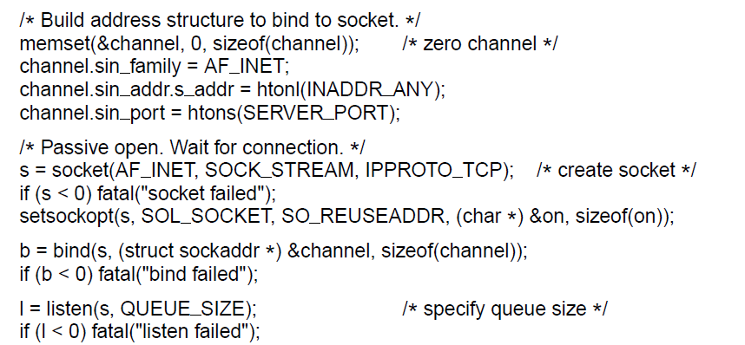
Example of Socket Programming:
An Internet File Server (5)
. . .
. . .
Server code

Slide 13
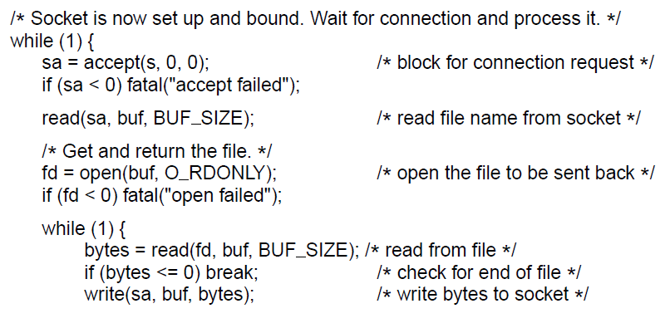
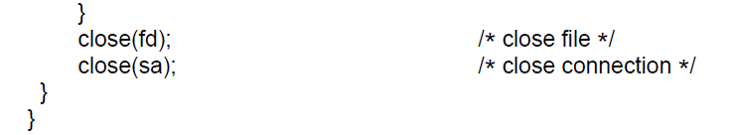
Example of Socket Programming:
An Internet File Server (6)
. . .
Server code

Slide 14
Elements of Transport Protocols (1)
Addressing
Connection establishment
Connection release
Error control and flow control
Multiplexing
Crash recovery

Slide 15
Similarity between data link and transport layer
Connection establishment
Connection release
Error control and flow control

Slide 16
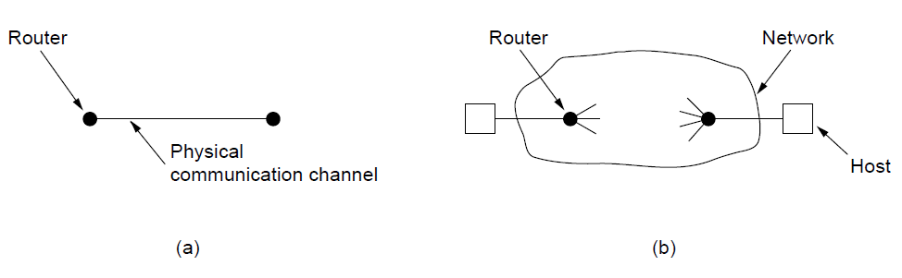
Elements of Transport Protocols (2)
Environment of the data link layer.
Environment of the transport layer.

Slide 17
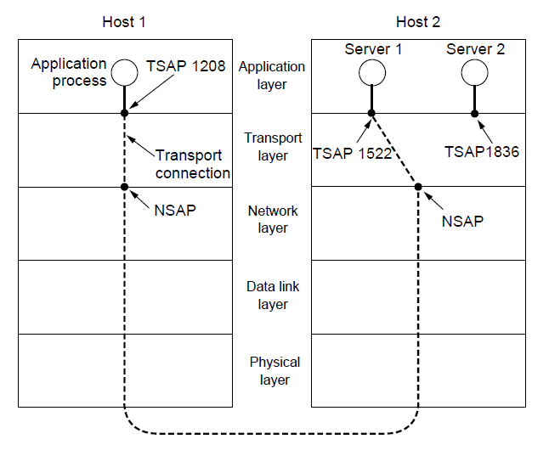
Addressing (1)
TSAPs, NSAPs, and transport connections

Slide 18
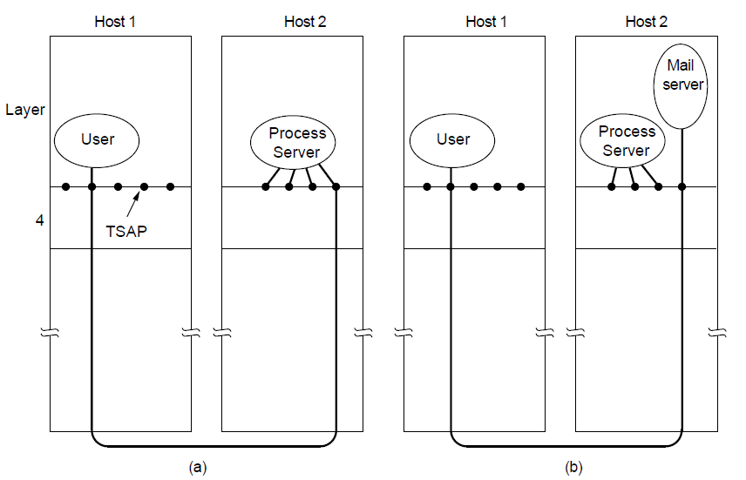
Addressing (2)
How a user process in host 1 establishes a connection
with a mail server in host 2 via a process server.

Slide 19
Connection Establishment (1)
Techniques to enable receiver to distinguish between retransmitted packets and packets delivered late:
    Throwaway transport addresses.
    Assign each connection a different identifier:
    <Peer transport entity, connection entity>
    Limitation: Nodes have to maintain history information indefinitely.

Slide 20
Connection Establishment (2)
Techniques for restricting packet lifetime:
Restricted network design.
Putting a hop counter in each packet.
Timestamping each packet.

Slide 21
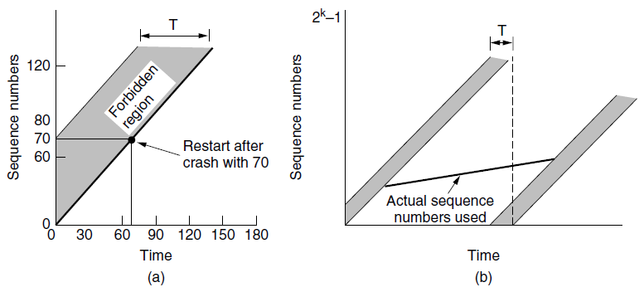
Connection Establishment (3)
Segments may not enter the forbidden region.
The resynchronization problem.

Slide 22
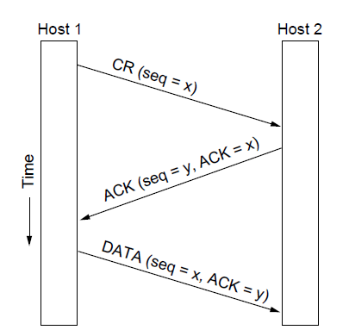
Connection Establishment (3)
3 protocol scenarios for establishing a connection using a 3-way handshake. CR denotes CONNECTION REQUEST.
(1) Normal operation.

Slide 23
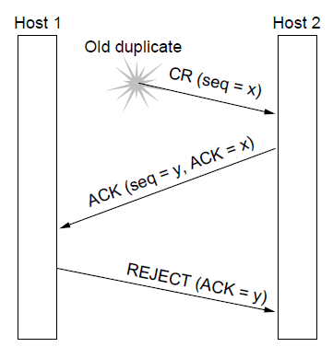
Connection Establishment (4)
3 protocol scenarios for establishing a connection using a 3-way handshake. CR denotes CONNECTION REQUEST.
(2) Old duplicate CONNECTION REQUEST appearing out of nowhere.

Slide 24
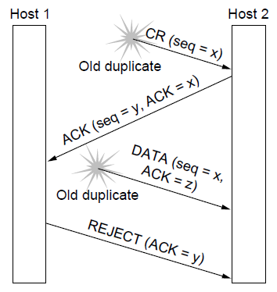
Connection Establishment (5)
3 protocol scenarios for establishing a connection using a 3-way handshake. CR denotes CONNECTION REQUEST.
(3) Duplicate CONNECTION REQUEST and duplicate ACK.

Slide 25
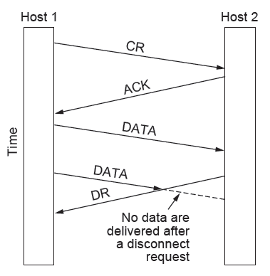
Connection Release (1)
Abrupt disconnection with loss of data – one way release or two way release

Slide 26
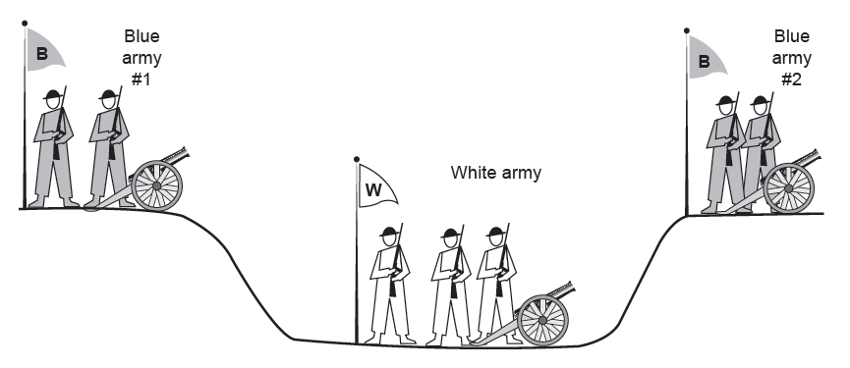
Connection Release (2)
The two-army problem
Synchronization which will go on infinitely

Slide 27
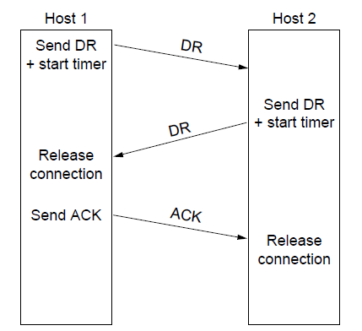
Connection Release (3)
Four protocol scenarios for releasing a connection.
(1) Normal case of three-way handshake

Slide 28
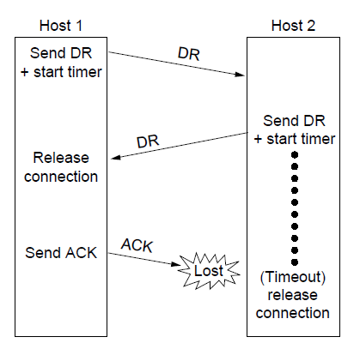
Connection Release (4)
Four protocol scenarios for releasing a connection.
(2) Final ACK lost.

Slide 29
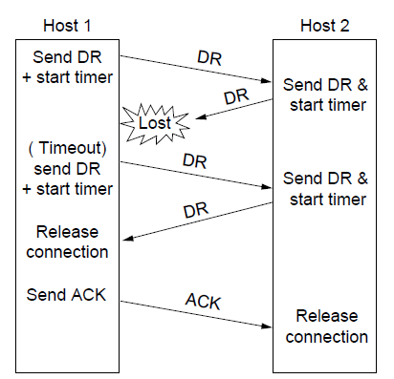
Connection Release (5)
Four protocol scenarios for releasing a connection.
(3) Response lost

Slide 30
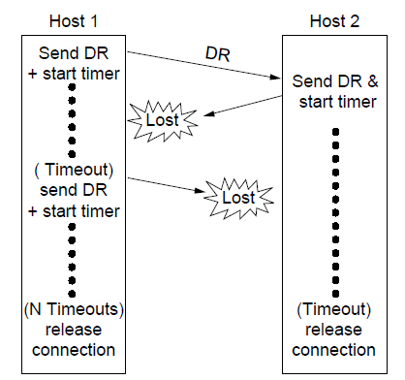
Connection Release (6)
Four protocol scenarios for releasing a connection.
(4) Response lost and subsequent DRs lost.

Slide 31
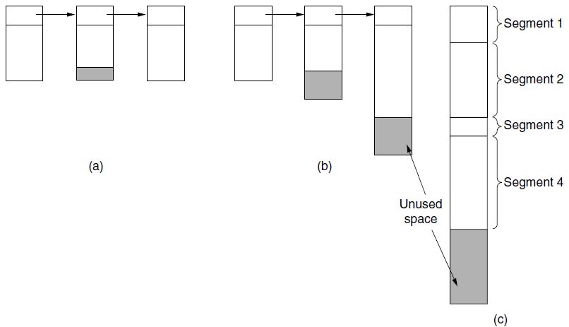
Error Control and Flow Control (1)
(a) Chained fixed-size buffers. (b) Chained variable-sized buffers. (c) One large circular buffer per connection.

Slide 32
Error Control and Flow Control (2)
For low-bandwidth bursty traffic, it is better not to allot buffer on connection establishment.
Dynamic allotment of buffer a better strategy.
Decouple sliding window protocol.

Slide 33
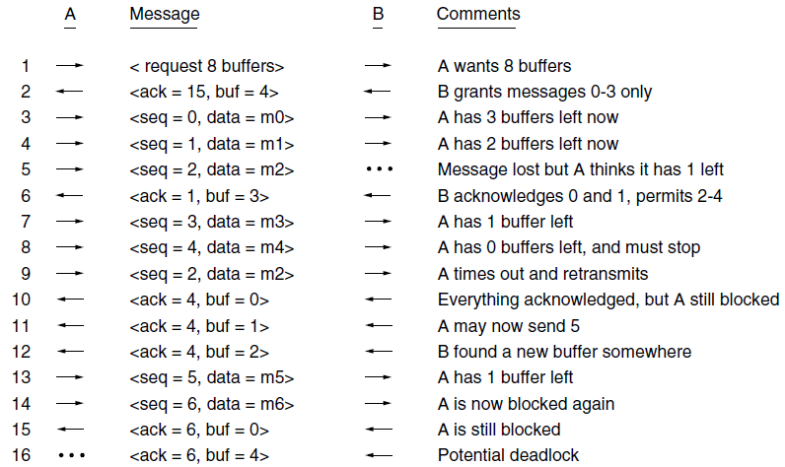
Error Control and Flow Control (3)
Dynamic buffer allocation. The arrows show the direction of transmission. An ellipsis (...) indicates a lost segment

Slide 34
Error Control and Flow Control (4)
Assuming buffer size is infinite, carrying capacity becomes a bottleneck.
If adjacent routers can exchange at most x packets/sec, and there are k disjoint paths between a pair of hosts,
max. rate of segment-exchange between hosts = kx segments/sec

Slide 35
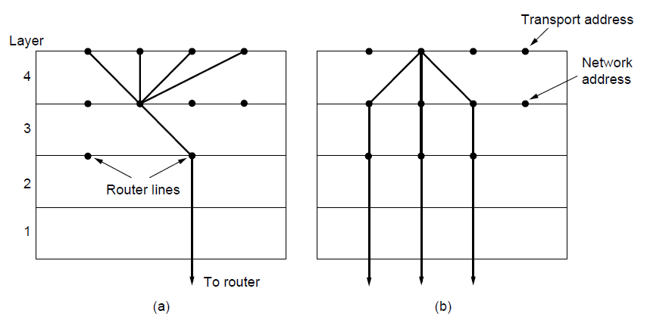
Multiplexing
(a) Multiplexing. (b) Inverse multiplexing.

Slide 36
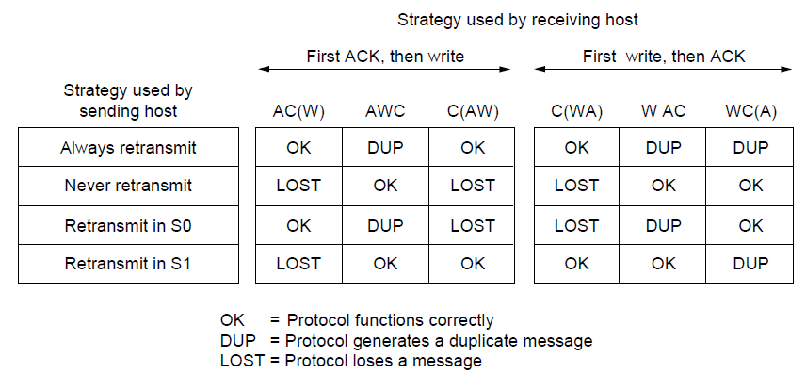
Crash Recovery
Different combinations of client and server strategies

Slide 37
Continued …
Chapter 6

